Slide 1
Organisational Behavior
Topic: Group Behavior & properties
Dr. C. Vijaya Banu
Professor , School of Management
SASTRA Deemed University, Thanjavur – 613 401
vijayabanu@mba.sastra.edu

Slide 2
Group Properties
Role(s)
Norms
Status
Size
Cohesiveness

Slide 3
Group Properties - Roles
Role(s)
A set of expected behavior patterns attributed to someone occupying a given position in a social unit.
Role Identity
Certain attitudes and behaviors consistent with a role.
Role Perception
An individual’s view of how he or she is supposed to act in a given situation.

Slide 4
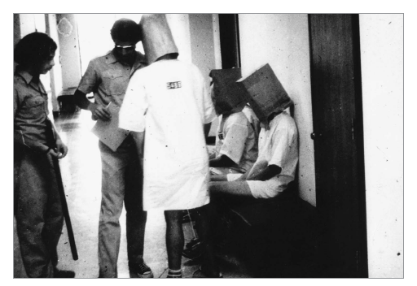
Group Properties - Roles (cont’d)
Role Expectations
How others believe a person should act in a given situation.
Psychological Contract
An unwritten agreement that sets out what management expects from the employee and vice versa.
Role Conflict
A situation in which an individual is confronted by divergent role expectations.

Slide 5
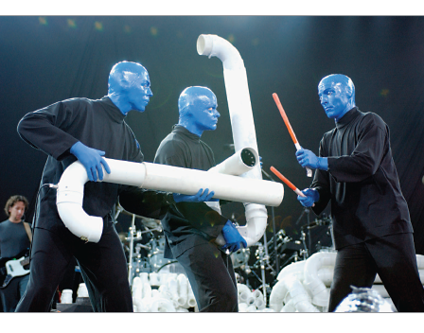
Group Properties - Norms
Norms
Acceptable standards of behavior within a group that are shared by the group’s members.
Classes of Norms:
Performance norms
Appearance norms
Social arrangement norms
Allocation of resources norms

Slide 6
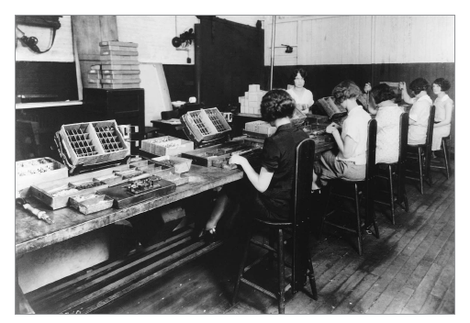
Group Norms & The Hawthorne Studies
A series of studies undertaken by Elton Mayo at Western Electric Company’s Hawthorne Works in Chicago between 1924 and 1932.
Research Conclusions:
Worker behavior and sentiments were closely related.
Group influences (norms) were significant in affecting individual behavior.
Group standards (norms) were highly effective in establishing individual worker output.
Money was less a factor in determining worker output than were group standards, sentiments, and security.

Slide 7
Group Properties - Norms (cont’d)
Conformity
Adjusting one’s behavior to align with the norms of the group.
Reference Groups
Important groups to which individuals belong or hope to belong and with whose norms individuals are likely to conform.

Slide 8
Group Properties - Norms (cont’d)
Deviant Workplace Behavior
Antisocial actions by organizational members that intentionally violate established norms and result in negative consequences for the organization, its members, or both.
Group norms can influence the
presence of deviant behavior.

Slide 9
Typology of Deviant Workplace Behavior
Category Examples Production Leaving early Intentionally working slowly Wasting resources
Property Sabotage Lying about hours worked Stealing from the organization
Political Showing favoritism Gossiping and spreading rumors Blaming coworkers
Personal Aggression Sexual harassment Verbal abuse Stealing from coworkers
Source: Adapted from S.L. Robinson, and R.J. Bennett. “A Typology of Deviant Workplace Behaviors: A Multidimensional Scaling Study,” Academy of Management Journal, April 1995, p. 565.

Slide 10
Group Properties - Status
Status: A socially defined position or rank given to groups or group members by others.
Power over Others
Norms & Interaction
Ability to Contribute
Group Member Status
Personal Characteristics
Other things influencing or influenced by status
Status Inequity
National Culture

Slide 11
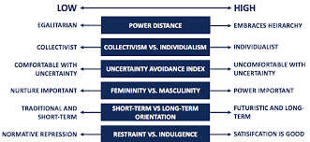
Cultural differences

Slide 12
Group Properties - Size
Social Loafing The tendency for individuals to expend less effort when working collectively than when working individually.
Performance
Other conclusions:
Odd number groups do better than even.
Groups of 5 to 7 perform better overall than larger or smaller groups.
Expected
Actual (due to loafing)
Group Size

Slide 13
Group Properties - Cohesiveness
Cohesiveness
Degree to which group members are attracted to each other and are motivated to stay in the group.
Increasing group cohesiveness:
Make the group smaller.
Encourage agreement with group goals.
Increase time members spend together.
Increase group status and admission difficultly.
Stimulate competition with other groups.
Give rewards to the group, not individuals.
Physically isolate the group.

Slide 14
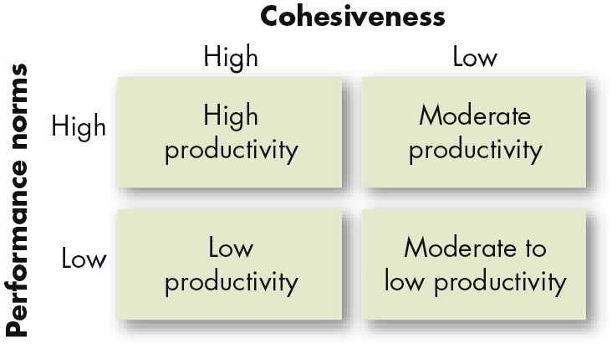
Relationship Between Group Cohesiveness, Performance Norms, and Productivity

Slide 15
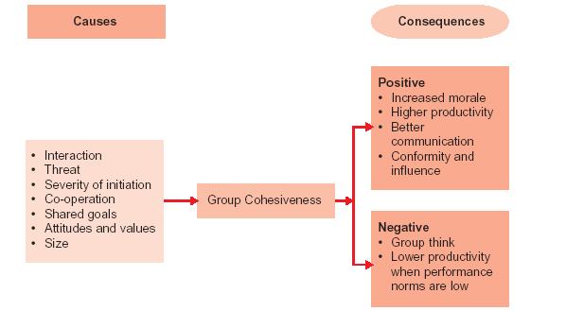
Group Cohesiveness – Causes and Consequences

Slide 16
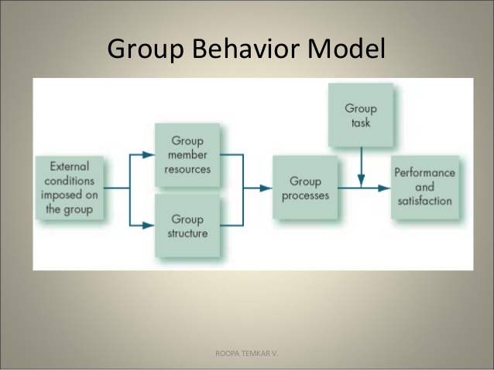

Slide 17
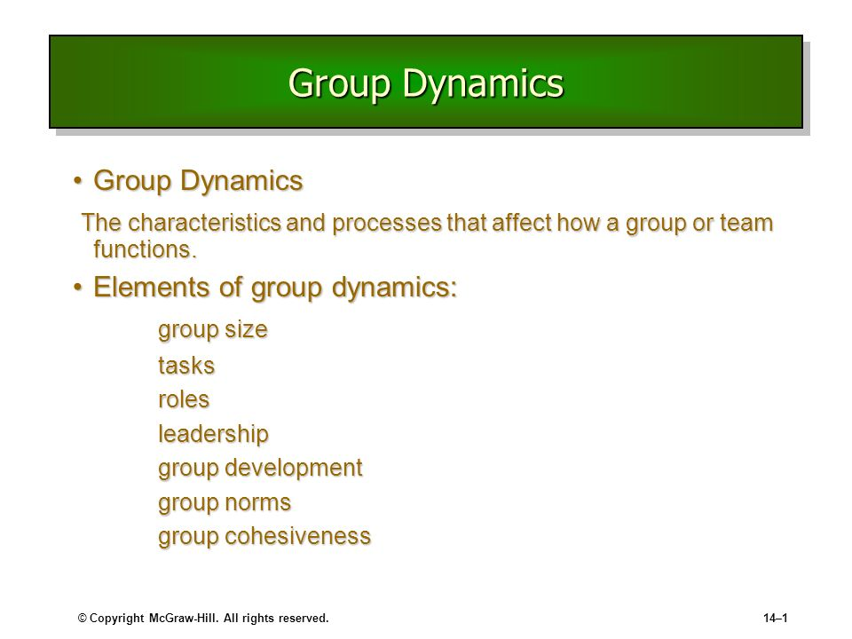

Slide 18
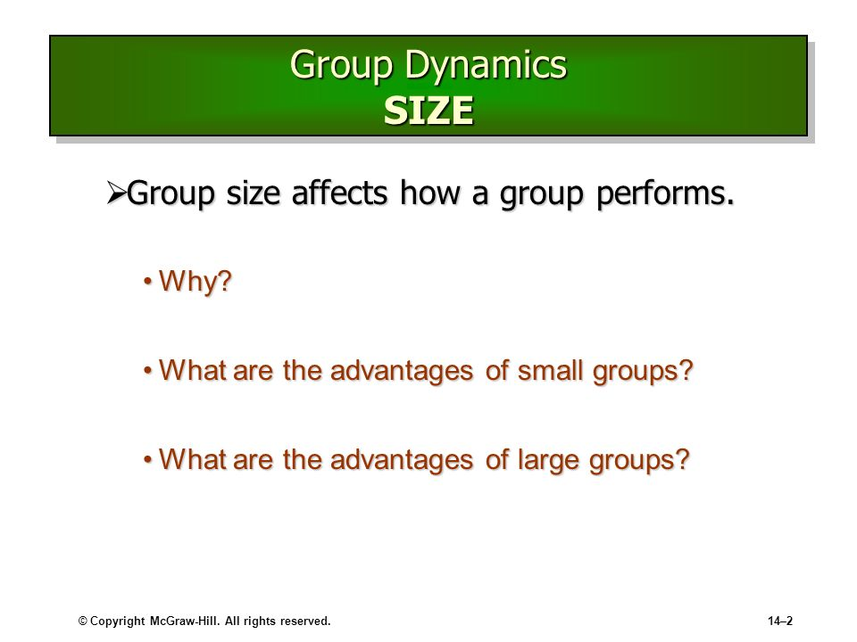

Slide 19
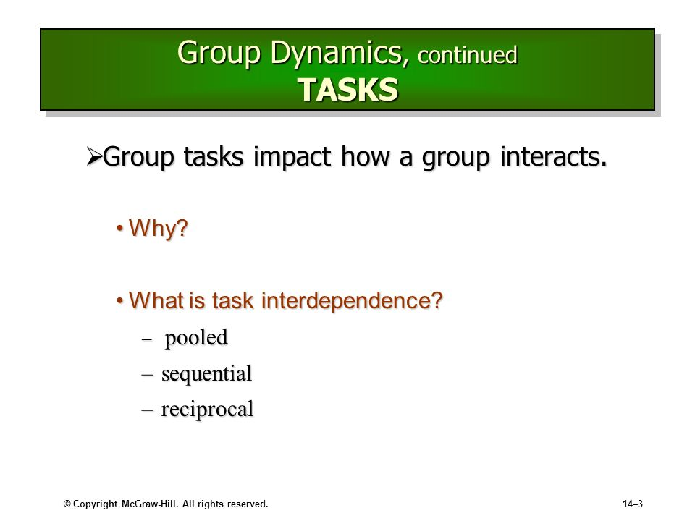

Slide 20
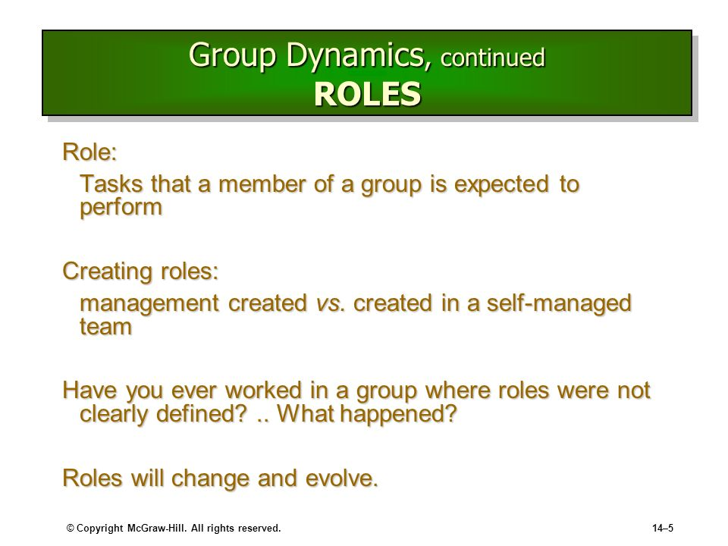

Slide 21
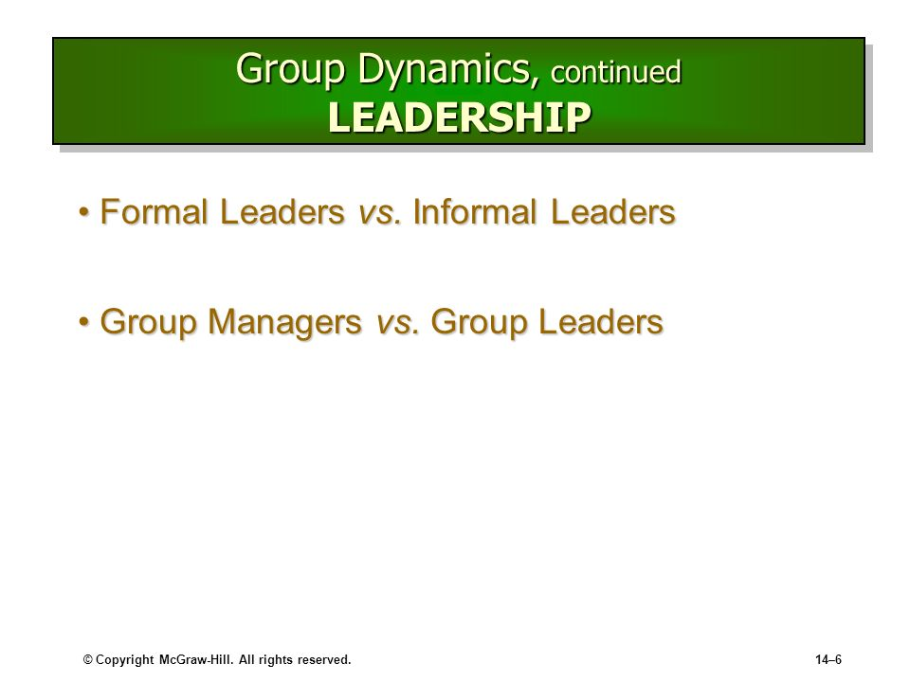

Slide 22
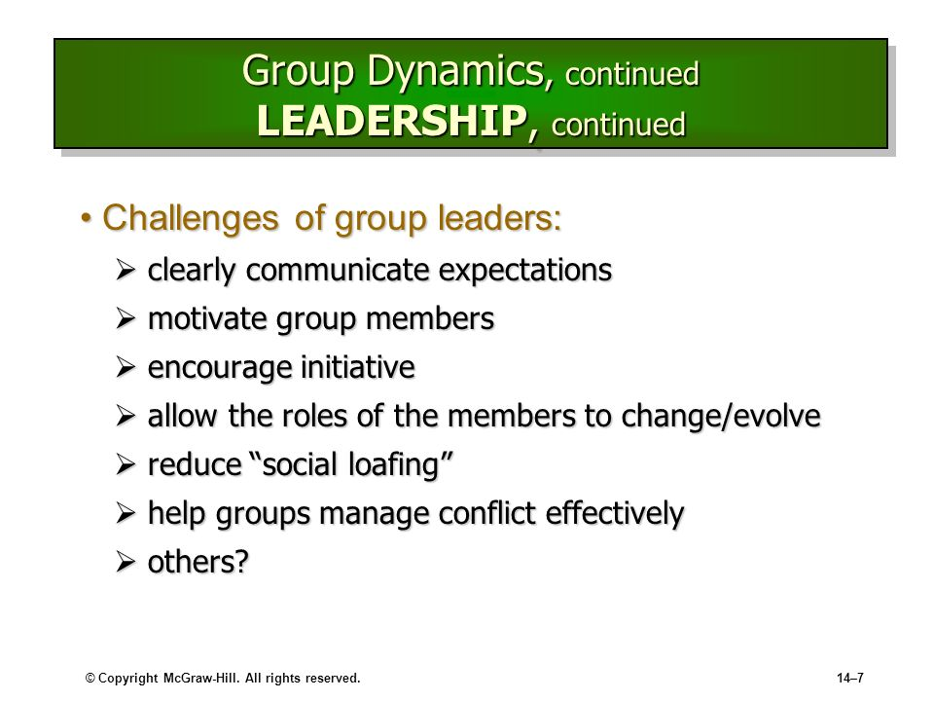

Slide 23
Social loafing is the phenomenon of a person exerting less effort to achieve a goal when they work in a group than when working alone. It is seen as one of the main reasons groups are sometimes less productive than the combined performance of their members working as individuals.
Groupthink is a psychological phenomenon that occurs within a group of people in which the desire for harmony or conformity in the group results in an irrational or dysfunctional decision-making outcome.
Group polarization is defined as a phenomenon when “members of a deliberating group move toward a more extreme point in whatever direction is indicted by the members' pre deliberation tendency.” Group polarization leads to changing attitudes among individuals within the group

Slide 24
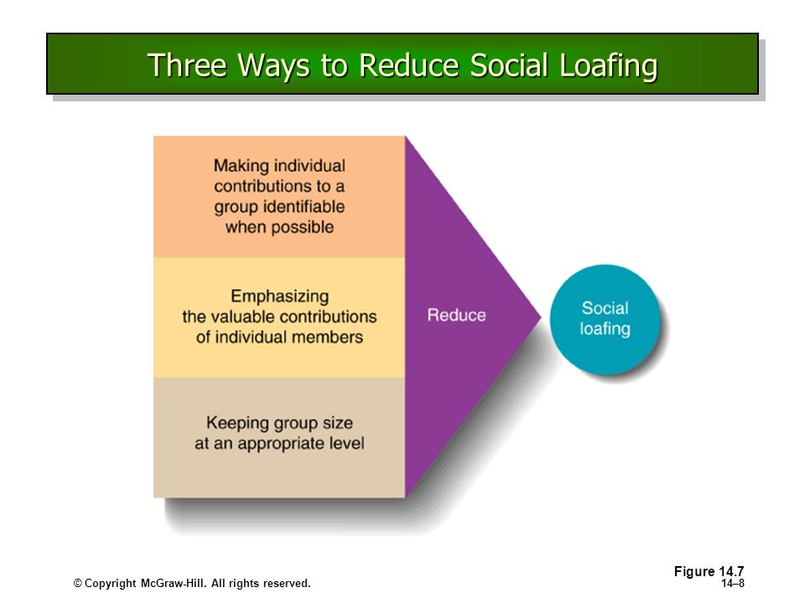

Slide 25
https://slideplayer.com/slide/5934352/
https://www.slideserve.com/carrington/group-dynamics
https://slideplayer.com/slide/9019415/

